Slide 1


Linear Network Coding
Shuo-Yen Robert Li
Department of Information Engineering
The Chinese University of Hong Kong

Slide 2
Linear Network Coding
The basic theory
Exemplifying applications
A little mathematical philosophy
Notes:
Both done 1997
Info-Thy society

Slide 3
Main Reference
Preliminary conference version:
Li & Yeung, “Network multicast flow via linear coding,” ISORA Conference, Kunming, China, 1998.
Journal paper:
Li, Yeung & Cai, “Linear Network Coding,” IEEE Trans. Info. Thy, 2/2003 (winner of The 2005 IEEE Information Theory Society Paper Award).
Follow-up paper:
Li, Yeung & Cai, “On the Theory of Linear Network Coding,” to appear.
Notes:
Both done 1997
Info-Thy society

Slide 4
To multicast two bits to Y and Z
Every arrow represents a channel for transmitting one bit.
S
b₁
b₂
T
U
W
X
Y
Z

Slide 5
Store-and-forward
Conventional way of message relay
b₁
S
b₁
S
b₂
b₂
T
U
T
U
b₁
b₂
b₁
b₂
W
W
b₁
b₂
b₁
?
b₂
b₁
b₂
b₂
X
X
b₁
Y
Z
Y
Z

Slide 6
Coding betters store-and-forward.
This is no longer store-and-forward.
Node W encodes by the linear mapping: (b₁, b₂) → b₁⊕ b₂
Nodes Y and Z decode.
Benefits of network coding:
Maximal bit rate
Minimal latency
Minimal energy consumption
…
b₁
S
b₂
T
U
b₁
b₂
W
b₁
b₂
b₁⊕ b₂
b₁⊕ b₂ b₁⊕ b₂
X
Y
Z
Notes:
this picture is an icon of network coding theory.

Slide 7
A Conversation between two
S
U
S’
S
U
S’
b₁
b₂
b₁
b₂
b₁
b₂
?
b₁⊕b₂
T
V
T’
T
V
T’
b₂
b₁
b₁⊕b₂
b₁⊕b₂

Slide 8
Relay transceiver between wireless base stations
Time slot 1:
b₂
b₁
Double the wireless range
Time slot 2:
b₂
Time slot 3:
b₁⊕b₂

Slide 9
Unfold the combined space-time domain
→ Logical equivalent to 2-party conversation
b₁
Time slot 1:
S
U
b₁
b₂
Time slot 2:
V
S’
b₁⊕ b₂
b₁⊕ b₂
b₁⊕ b₂
Time slot 3:
T
W
T’

Slide 10
Linear network coding
Linearity in encoding → Conceptual simplicity
Implementation by simple and fast circuitry or software
Suffices to achieve best possible effect of network coding

Slide 11
Avalanche of Microsoft
 | Dominating Internet traffic | Exemplifying tool before Microsoft | Microsoft tool | Theoretic basis for improvement
Old day | Web browsing | Netcape | e | None
Now | Peer-to-peer (P2P) | BitTorrent | Avalanche | Network coding +20~30% throughput improved security

Slide 12
Formulation of linear network coding
The source generates a message, which is expresses as an ω-dim row vector over a base field F.
In this case, ω = 2, F = GF(2), and message = (b₁ b₂).
b₁
b₂
b₁
S
b₂
S
T
U
b₁
b₂
W
b₁
T
U
b₂
b₁⊕ b₂
b₁⊕ b₂ b₁⊕ b₂
X
Y
Z

Slide 13
Formulation of linear network coding (Cont’d)
Inside node S, there is a linear gain from every input to every output. This linear gain, a scalar in the base field, is called a local encoding kernel.
b₁
b₂
S
1
1
0 0
b₁
b₂
b₁
S
b₂
T
U
T
U
b₁
b₂
W
b₁
b₂
b₁⊕ b₂
b₁⊕ b₂ b₁⊕ b₂
X
Y
Z

Slide 14
Formulation of linear network coding (Cont’d)
Progressing from S downward, inside each node T, U, W, … there is also a local encoding kernel from every input to every output.
b₁
b₂
S
1
1
0 0
b₁
S
b₁
b₂
b₂
T
U
T
U
b₁
b₂
1 1
1 1
W
b₁
W
b₂
b₁
b₂
b₁⊕ b₂
b₁⊕ b₂ b₁⊕ b₂
b₁
b₂
1 1
X
Y
Z
b₁⊕ b₂

Slide 15
Definition of a linear network code
Definition 1. ‎Let F = finite field and ω = positive integer. An ω-dim F-valued linear network code on an acyclic network consists of a local encoding kernel k_{d,e} ∈ F for every adjacent pair (d, e).
An adjacent pair (d, e) of channels
means that there is a node T with
d ∈ In(T) and e ∈ Out(T), where
In(T)/Out(T) are sets of
incoming/outgoing channels of T.
S
1
1
0 0
T
U
1 1
1 1
W
1 1
X
Note the ω imaginary channels
in In(S).
1 1
Y
Z

Slide 16
Global encoding kernels
Definition 1 (cont’d). An ω-dim F-valued linear network code consists of … The linear network code also assigns an ω-dim vector f_{e} as the global encoding kernel for each channel e such that
Recursion⎯When e ∈ Out(T),
f_{e} = Σ_{d∈In(T)} k_{d,e} f_{d}
Initial condition⎯f_{e} for the ω
imaginary channels e form the
natural basis of the space F^{ω}.
1
0
0
1
S
1
1
0 0
1
0
0
1
T
U
1 1
1 1
W
1
0
0
1
1 1
1
0
0
1
1
1
X
The scalar transmitted over e is
message • f_{e}
1
1
1 1
1
1
Y
Z

Slide 17
Decoding by global encoding kernels
1
0
0
1
Juxtapose f_{TY} and f_{XY} into the matrix
M_{Y} =
When the source sends out the 2-dim message (b₁ b₂), the node Y receives
(b₁ b₁+b₂) = (b₁ b₂) • M_{Y}
and decodes the message by
(b₁ b₁+b₂) • M_{Y}⁻¹ = (b₁ b₂)
Conditions for decodability at Y:
Node Y must know global encoding
kernels for its incoming channels.
These global encoding kernels span
the full rank ω (=2 in this example).
S
1 1
0 1
1
1
0 0
1
0
0
1
T
U
1 1
1 1
W
1
0
0
1
1 1
1
0
0
1
1
1
X
1
1
1 1
1
1
Y
Z

Slide 18
How are global encoding kernels known?
Fixed linear network coding⎯e.g., in wireless applications
Local/global encoding kernels are fixed and known.
Over a fixed acyclic network
Random network coding⎯e.g., Avalanche, newly announced Microsoft version of BitTorrent
Local encoding kernels are randomly generated.
The scalar ∈ F transmitted over a channel e is formatted as a
packet, in which the header contains f_{e}.

Slide 19
Random (linear) network coding
1
0
0
1
S
Take a large base field
F = {0, 1, …, α, …, β, … }
1
1
0 0
1
0
0
1
T
U
1 1
1 1
W
1
0
0
1
α β
1
0
α
β
0
1
X
α
β
1 1
α
β
Y
Z

Slide 20
Do global encoding kernels span full rank?
Fixed linear network coding
When the base field F is large enough, we can construct optimal
linear network codes so that global encoding kernels span as
high ranks as possible.
Random (linear) network coding
When the base field F is large enough, a randomly generated
linear network code is optimal with probability close to 1.

Slide 21
Recall decoding by global encoding kernels
1
0
0
1
Juxtapose f_{TY} and f_{XY} into the matrix
M_{Y} =
When the source sends out the 2-dim message (b₁ b₂), the node Y receives
(b₁ b₁+b₂) = (b₁ b₂) • M_{Y}
and decodes the message by
(b₁ b₁+b₂) • M_{Y}⁻¹ = (b₁ b₂)
Conditions for decodability at Y:
Node Y knows global encoding
kernels for its incoming channels.
These global encoding kernels span
the full rank ω (=2 in this example).
S
1 1
0 1
1
1
0 0
1
0
0
1
T
U
1 1
1 1
W
1
0
0
1
1 1
1
0
0
1
1
1
X
1
1
1 1
1
1
Y
Z

Slide 22
Linear multicast
Definition. Consider an ω-dimensional F-valued linear network code on an acyclic network. Adopt the abbreviation
V_{T} = ⟨{f_{d}: d ∈ In(T)}⟩
Then, the linear network code qualifies as a linear multicast if
dim(V_{T}) = ω
for every non-source node T with maxflow(T) ≥ ω.
Application. Intended destinations are those nodes T with maxflow(T) ≥ ω.

Slide 23
Construction of linear multicast [K-M Trans.IT’03]
Let T be a non-source node with maxflow(T) ≥ ω. There exist ω disjoint paths from the ω imaginary channels to ω distinct channels in In(T).
S
Juxtapose global encoding kernels for these ω channels in an ω×ω matrix L_{T}. Then, det(L_{T}) is a polynomial, where the variables are local encoding kernels. We would like det(L_{T}) ≠ 0 so that T can receive the full message. Same for T′.
So we would like det(L_{T})·det(L_{T′}) ≠ 0. When the base field is large enough, …
T
T′

Slide 24
Modified construction of linear multicast [S-E-T ACM SPAA‘03]
Polynomial-time algorithm :
Let T₁, T₂, … , T_{m} list all the non-source nodes T with maxflow(T) ≥ ω.
Leading to T_{q}, 1 ≤ q ≤ m, there exist channel-disjoint paths P_{q,1}, P_{q,2}, … , P_{q,ω}.
S
{for each node (upstream to downstream)
{for each outgoing channel e
{Choose a vector w in V_{T} such that
w ∉ ⟨{f_{q,j} : j ≠ i}⟩ for every pair (q, i);
f_{e} = w;
} } }
T
T′

Slide 25
Key ideas of the construction
Stage 1: For each sink t, find m edge-independent paths (flows). Only the edges in the union of these flows are considered in the second stage of the algorithm.
Stage 2: A greedy algorithm that visits each edge in turn and designs the linear coding employed for that edge. The order for visiting the edges is chosen so that the encoding for edge e is designed after the encodings for all edges leading to e. The goal in designing the encoding for e=(v,w) is to choose a linear combination of the inputs to node that ensures that all sinks that lie downstream from e obtain linearly m independent combinations of the original source symbols.

Slide 26
An example over field GF(2)
0
1
0
1
0
0
1
0
0
0
1
1
0
1
0
1
For each sink t, find m
edge-independent paths (flows).
Only the edges in the union of these flows are considered in the second stage of the algorithm.
e₁
e₂
S
e₃
e₄
e₆
e₇
e₅
e₉
e₈
Y
e₁₀
e₁₁
Z

Slide 27
An example over field GF(2)
0
1
0
1
0
0
1
0
0
0
1
1
0
1
0
1
Consider edge e₁ and edge e₂ :
e₁
e₂
S
e₃
e₄
e₆
e₇
e₅
e₉
e₈
Y
e₁₀
e₁₁
Z

Slide 28
An example over field GF(2)
0
1
0
1
0
0
1
0
0
0
Choose these two coefficients appropriately
such that both B_{Y} and B_{Z} have full rank
1
1
0
1
0
1
Consider edge e₃:
e₁
e₂
S
e₃
e₄
e₆
e₇
e₅
e₉
e₈
Y
e₁₀
e₁₁
Z

Slide 29
An example over field GF(2)
0
1
0
1
0
0
1
0
0
0
Choose these two coefficients appropriately
such that both B_{Y} and B_{Z} have full rank
1
1
0
1
0
1
Consider edge e₄:
e₁
e₂
S
e₃
e₄
e₆
e₇
e₅
e₉
e₈
Y
e₁₀
e₁₁
Z

Slide 30
An example over field GF(2)
0
1
0
1
0
0
1
0
0
0
1
1
0
1
0
1
Consider edge e₅:
e₁
e₂
S
e₃
e₄
e₆
e₇
e₅
e₉
e₈
Y
e₁₀
e₁₁
Z

Slide 31
An example over field GF(2)
0
1
0
1
0
0
1
0
0
0
1
1
0
1
0
1
Consider edge e₆:
e₁
e₂
S
e₃
e₄
e₆
e₇
e₅
e₉
e₈
Y
e₁₀
e₁₁
Z

Slide 32
An example over field GF(2)
0
1
0
1
0
0
1
0
0
0
1
1
0
1
0
1
Consider edge e₇:
e₁
e₂
S
e₃
e₄
e₆
e₇
e₅
e₉
e₈
Y
e₁₀
e₁₁
Z

Slide 33
An example over field GF(2)
0
1
0
1
0
0
1
0
0
0
1
1
0
1
0
1
Consider edge e₈:
e₁
e₂
S
e₃
e₄
e₆
e₇
e₅
e₉
e₈
Y
e₁₀
e₁₁
Z

Slide 34
An example over field GF(2)
0
1
0
1
0
0
1
0
0
0
Choose these two coefficients appropriately
such that both B_{Y} and B_{Z} have full rank
1
1
0
1
0
1
Consider edge e₉:
e₁
e₂
S
e₃
e₄
e₆
e₇
e₅
e₉
e₈
Y
e₁₀
e₁₁
Z

Slide 35
An example over field GF(2)
0
1
0
1
0
0
1
0
0
0
1
1
0
1
0
1
Consider edge e₁₀:
e₁
e₂
S
e₃
e₄
e₆
e₇
e₅
e₉
e₈
Y
e₁₀
e₁₁
Z

Slide 36
An example over field GF(2)
0
1
0
1
0
0
1
0
0
0
1
1
0
1
0
1
Consider edge e₁₁:
e₁
e₂
S
e₃
e₄
e₆
e₇
e₅
e₉
e₈
Y
e₁₀
e₁₁
Z

Slide 37
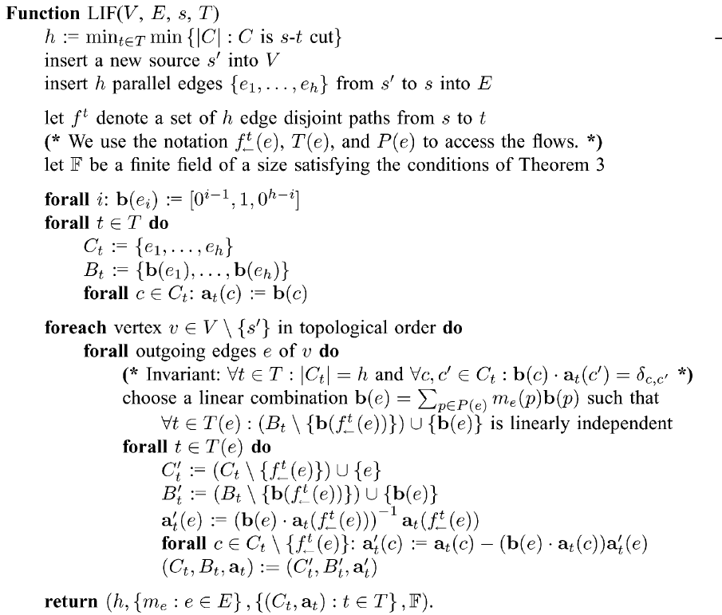

Slide 38
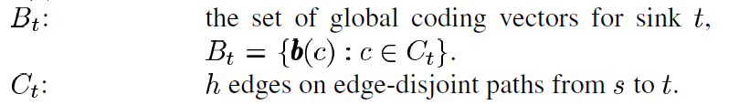
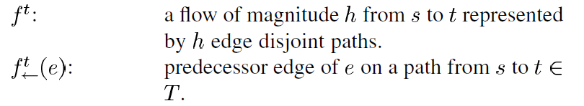
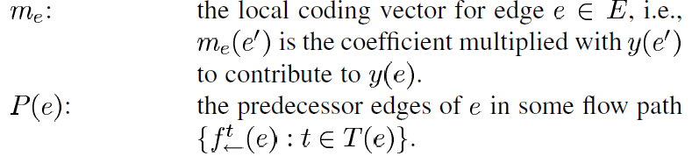
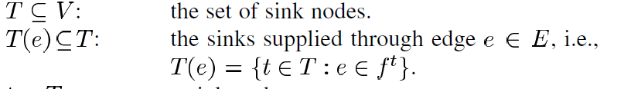

Slide 39
Main Reference
Preliminary conference version:
Li & Yeung, “Network multicast flow via linear coding,” ISORA Conference, Kunming, China, 1998.
Journal paper:
Li, Yeung & Cai, “Linear Network Coding,” IEEE Trans. Info. Thy, 2/2003 (winner of The 2005 IEEE Information Theory Society Paper Award).
Follow-up paper:
Li, Yeung & Cai, “On the Theory of Linear Network Coding,” to appear.
Notes:
Both done 1997
Info-Thy society

Slide 40
Additional references
Alshwede-Cai-Li-Yeung, “Network Information Flow,” IEEE Trans. Info. Thy, Feb. 2000.
Koetter-Medard, "An Algebraic Approach to Network Coding,” IEEE Trans. Info. Thy, Oct. 2003.
Sanders-Egner-Tolhuizen, "Polynomial time algorithms for the construction of multicast network codes", Allerton Conference, Oct. 2003.
Li-Yeung, “On Convolutional Network Coding,” to appear.
Yeung-Li-Cai-Zhang, “Theory of Network Coding,” Monograph for ‘06.
Applications to peer-to-peer communications, wireless networks, multicast, sensor networks, lossy networks, etc. :
Proceedings of ISIT’05
Network Coding Homepage, http://www.networkcoding.info
Notes:
Both done 1997
Info-Thy society

Slide 41
Ongoing & future directions
Convolutional network coding
The factor of base field
Multiple sources, each with a different set of destinations
Linear network code that tolerates link failure
Extension of existing applications
Visit http://www.networkcoding.info
New applications
…

